Slide 1

Fintech and Banks: Partnership or Competition?
How CBG Can Leverage the New Normal

Slide 2

Consolidated Bank Ghana (CBG)
Consolidated Bank Ghana (CBG) is a state-owned commercial bank in Ghana that provides a wide range of banking and financial services to individuals and businesses.

Slide 3






Introduction
Financial Sector Transformation
Fintech's Impact
Key Question
The financial industry is undergoing a significant shift driven by the rise of financial technology (fintech).
Fintech innovations are disrupting traditional banking models and changing the way financial services are delivered.
Are fintech companies partners or competitors to established banks?
This presentation will explore the relationship between fintech and banks, and how Consolidated Bank Ghana (CBG) can adapt and thrive in this evolving landscape.

Slide 4
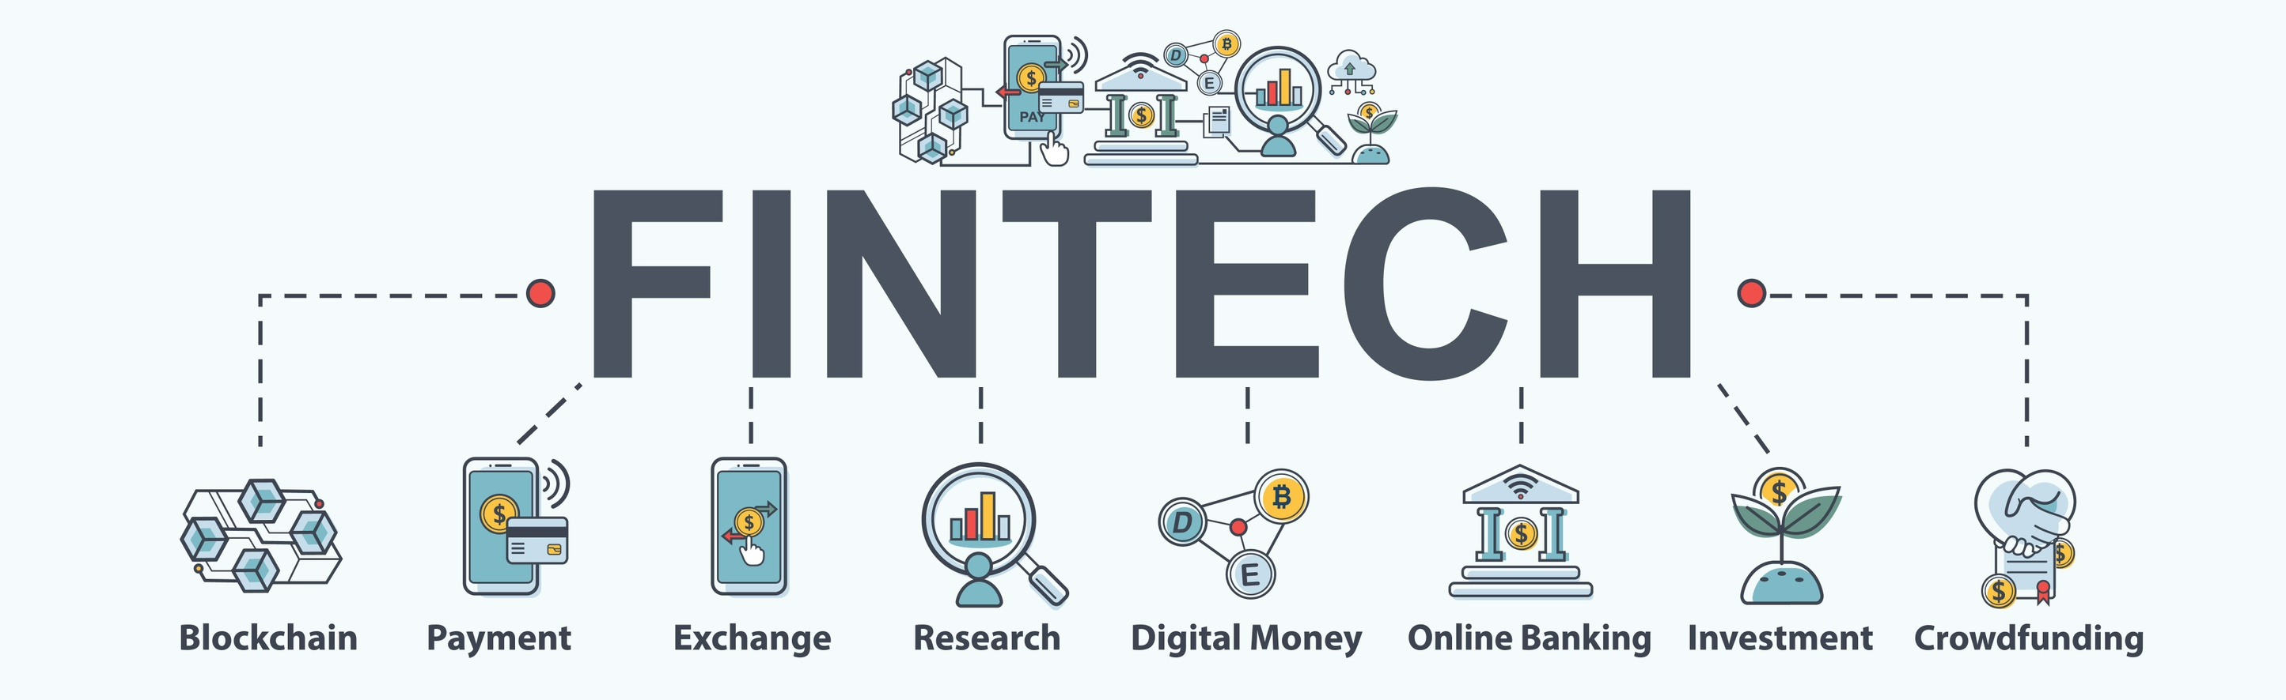
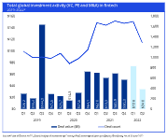
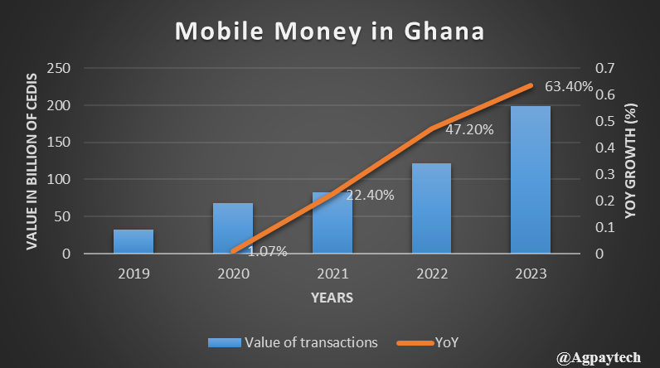

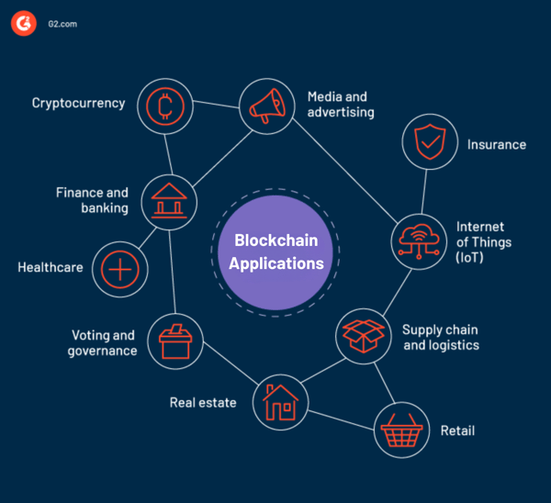
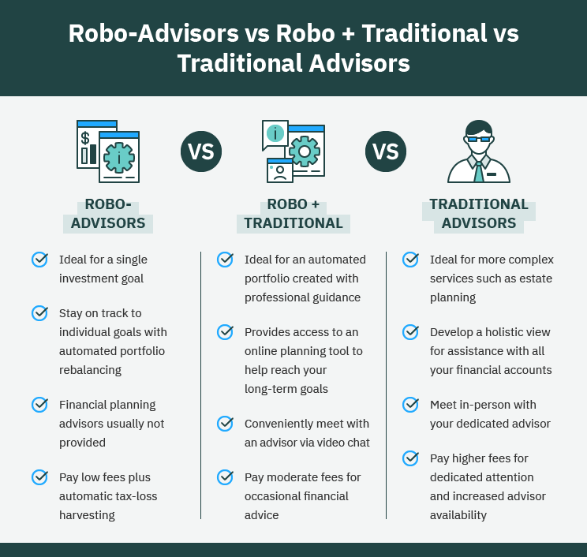
The Rise of Fintech
Fintech Definition
Global Fintech Investment
Mobile Money Growth in Ghana
Mobile Payment Solutions
Blockchain Applications
Robo-Advisors
Fintech refers to technology-driven financial services and products that aim to improve and automate the delivery and use of financial services.
Robo-advisors like Betterment and Wealthfront are providing automated, algorithm-driven financial planning and investment management services to customers.
Global fintech investments reached $105 billion in 2020, showcasing the significant growth and investment in the fintech industry.
In Ghana, mobile money transactions grew by 120% from 2019 to 2020, highlighting the rapid adoption of digital financial services in the country.
Innovative mobile payment solutions like M-Pesa and Apple Pay are disrupting traditional banking by providing convenient, cashless transactions.
Blockchain technology is enabling new financial services like cryptocurrencies and smart contracts, revolutionizing the way we transfer and secure digital assets.

Slide 5
Opportunities for CBG
Fintech Partnerships
Integrated Solutions
Cross-Selling Opportunities
CBG can collaborate with fintech companies to offer innovative financial services, such as digital lending, mobile payments, and wealth management, to its existing customer base.
By integrating fintech solutions into its existing banking platform, CBG can provide a seamless and enhanced customer experience, catering to the evolving digital needs of its clients.
Leveraging its extensive customer base, CBG can cross-sell fintech-powered products and services, such as peer-to-peer lending, cryptocurrency trading, or robo-advisory services, to its existing clients.
Data-Driven Insights
Regulatory Compliance
By analyzing customer data and behavior patterns, CBG can work with fintech partners to develop personalized financial products and services, tailored to the specific needs of its customer segments.
CBG's existing regulatory expertise and compliance framework can help fintech partners navigate the complex regulatory landscape, ensuring the delivery of compliant and secure financial services.

Slide 6
Banks and Fintech: Partnership or Competition?
Percentage of consumers using fintech services in various countries
87%
72%
71%
46%
35%
China
India
United Kingdom
United States
Germany

Slide 7







Strategies for Successful Partnerships
Gain a deep understanding of the fintech ecosystem, its emerging trends, and the unique capabilities of different fintech companies. This will help you identify the right partners that complement your bank's strengths.
Define the specific business objectives you want to achieve through the partnership, such as improving customer experience, enhancing product offerings, or expanding reach. Clearly articulate the value proposition for both parties.
Cultivate a culture of collaboration, open communication, and mutual respect between the bank and fintech partners. Encourage cross-functional teams to work together to overcome challenges and achieve shared goals.
Ensure that the partnership complies with all relevant banking regulations and industry standards. Collaborate to establish robust risk management frameworks and address any regulatory concerns early on.
Understand the Fintech Landscape
Establish Clear Objectives and Value Proposition
Foster Collaborative Culture
Align Regulatory and Compliance Requirements
Leverage Complementary Strengths
Invest in Technology Integration
Continuously Evolve and Innovate
Identify and leverage the unique strengths of both the bank and the fintech company. The bank can provide regulatory expertise, customer base, and infrastructure, while the fintech can bring agility, innovative technologies, and customer-centric approaches.
Invest in seamless technology integration between the bank's and fintech's systems to enable a frictionless customer experience. Prioritize data security, scalability, and flexibility in the integration process.
Establish a process for regularly reviewing the partnership, evaluating its performance, and adapting to changing market conditions and customer needs. Encourage a culture of continuous innovation and experimentation to stay ahead of the curve.

Slide 8




Conclusion
Fintech is reshaping the financial industry
Partnership and competition present opportunities for banks
CBG can leverage digital transformation, customer experience, and strategic collaborations
The rapid growth and innovation in fintech are transforming the traditional banking landscape.
Banks can leverage fintech partnerships to access new technologies and expand their customer base, while also facing competition in certain financial services.
CBG should focus on implementing a comprehensive digital transformation strategy, enhancing customer experience, and exploring strategic partnerships with local and international fintech firms.
Continuous evolution of the fintech landscape
The fintech industry is expected to continue evolving, with further innovations and disruptions that will require banks to remain agile and adaptable.

